Slide 1
Natural Language Processing
Introduction to LLM
Prompt engineering

Slide 2
Session Content
Introduction to LLM
Prompt engineering
Generaive AI
Large language model (LLM) enhancement

Slide 3
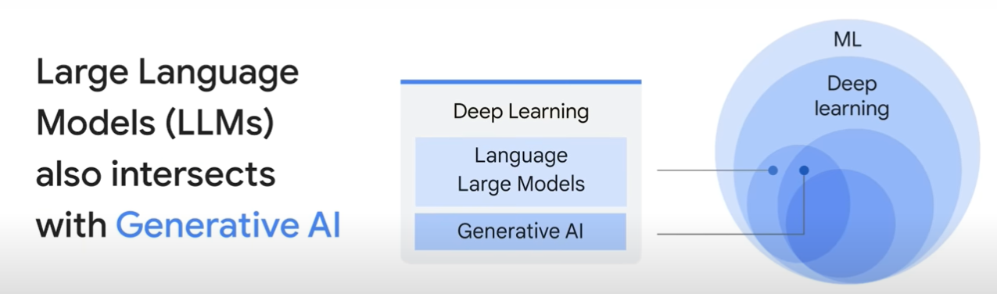
Large Language Models

Slide 4
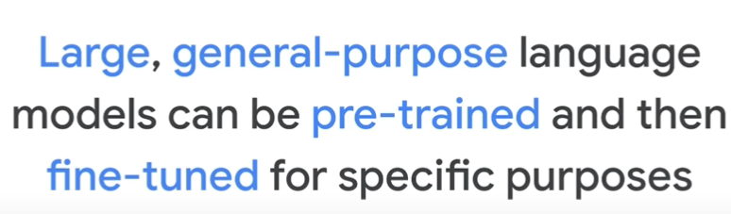
Large Language Models

Slide 5
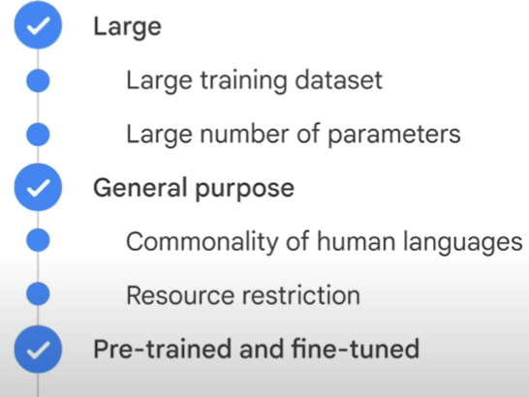
Large Language Models

Slide 6
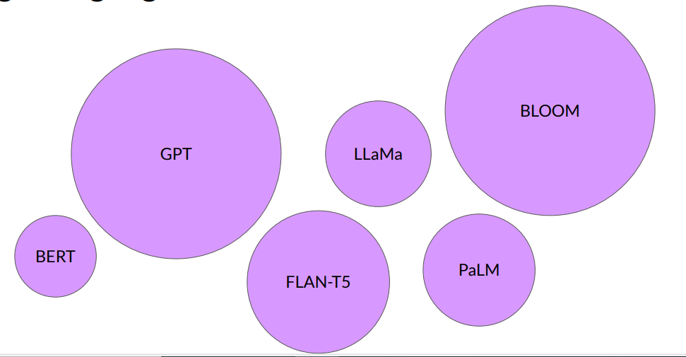
Large Language Models

Slide 7
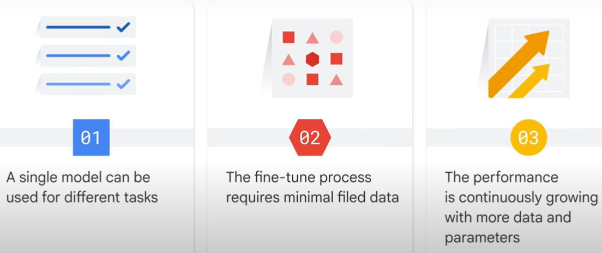
Benefits of using Large Language Models

Slide 8
Traditional ML: - Need ML knowledge - Collect training data - Choose and train model - More time + GPU/hardware - Minimize loss function LLM Development: - Use pre-trained model/API - No training from scratch - No large dataset needed - Focus on prompt writing

Slide 9
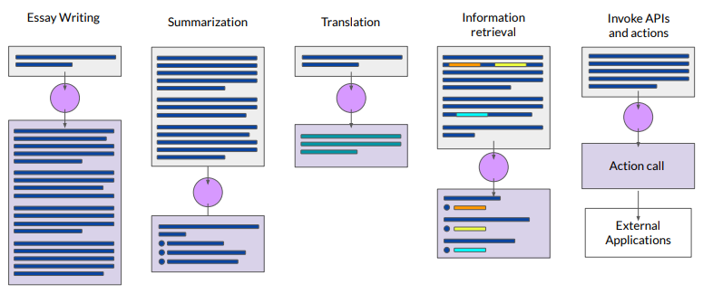
LLM Use Cases

Slide 10
What is prompt engineering
What is a prompt?
A prompt refers to the input or query provided to the AI model to generate a response. It can be a sentence, a question, or a combination of multiple sentences. The prompt sets the context and guides the model in understanding the desired task or the information it needs to generate its response.
What is prompt engineering?
Prompt engineering refers to the practice of crafting prompts or input text to LLMs in a way that optimizes their performance and output. It involves carefully selecting and formulating input text to elicit the desired response from the LLM.

Slide 11
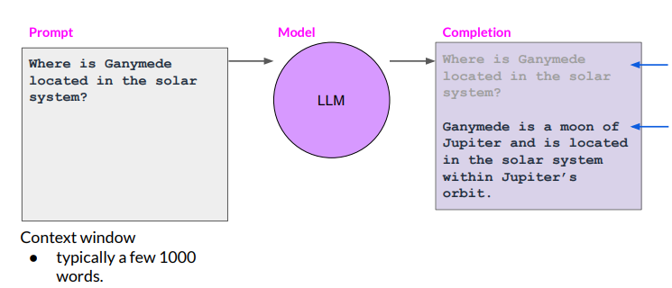


Prompts and Completions

Slide 12
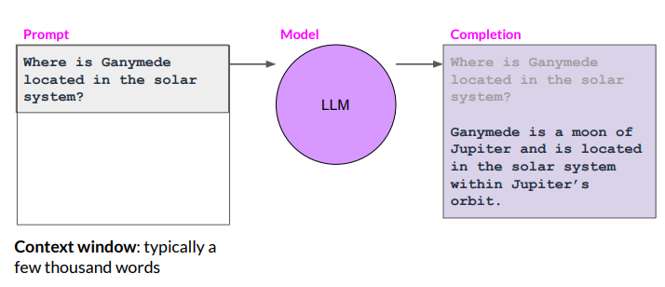
Prompting and Prompt Engineering

Slide 13
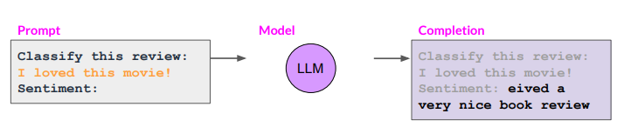




In context learning and
zero shot inference

Slide 14
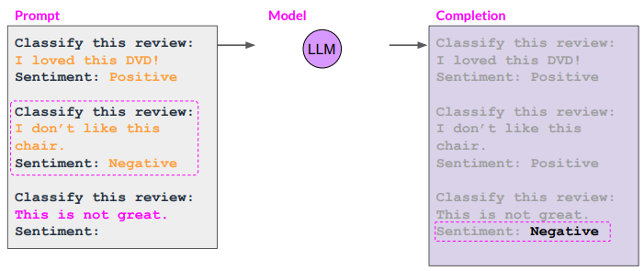
In context learning and
Few shot inference

Slide 15
Chain-of-Thought (CoT) Prompting
Chain-of-Thought prompting encourages the model to break a complex problem into intermediate reasoning steps.
It helps improve performance on tasks involving logic, mathematics, and multi-step reasoning.
Example: 'Solve the problem step by step and explain your reasoning.'

Slide 16













Slide 17
Advantages of Chain-of-Thought (CoT) Prompting
Improves complex reasoning
Reduces mistakes
Makes the model's reasoning more understandable
Useful for complex tasks
Helps in difficult or ambiguous problems

Slide 18
Generated Knowledge Prompting
Generated knowledge prompting asks the model to first generate relevant background information before answering a question.
The generated knowledge provides additional context that improves the final response.
Example: Generate facts about climate change before answering a detailed climate-related question.

Slide 19
Example : Medical Domain
User question:
"Why do people with diabetes need to monitor their blood sugar?"
Step 1: Generate knowledge
Diabetes affects the body's ability to regulate blood glucose.
High blood sugar can damage organs.
Low blood sugar can also be dangerous.
Step 2: Final answer
People with diabetes monitor blood sugar to maintain healthy glucose levels and avoid complications.

Slide 20
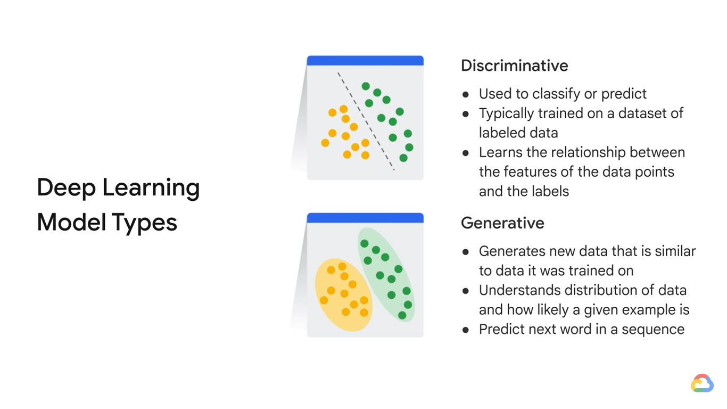
DL Model Types

Slide 21
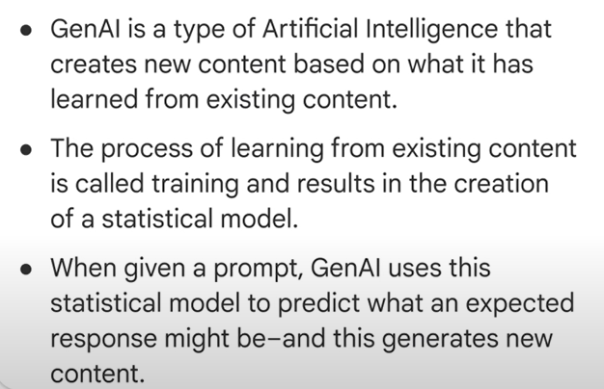












Generative AI

Slide 22
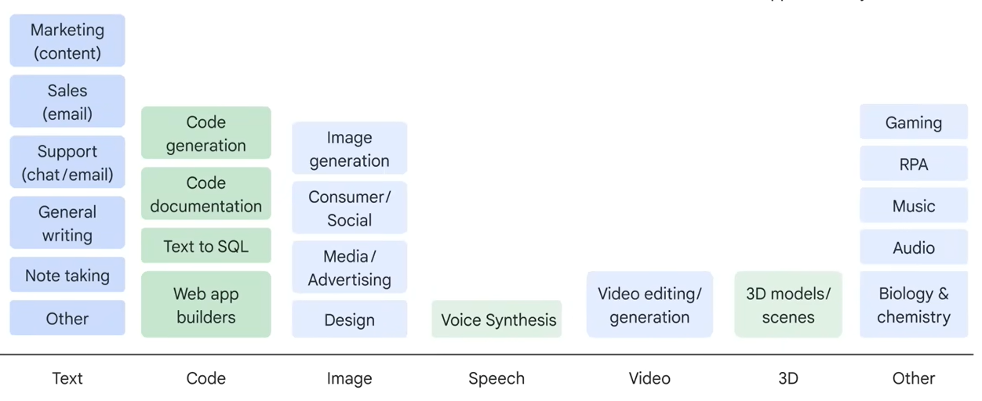
Generative AI Applications

Slide 23
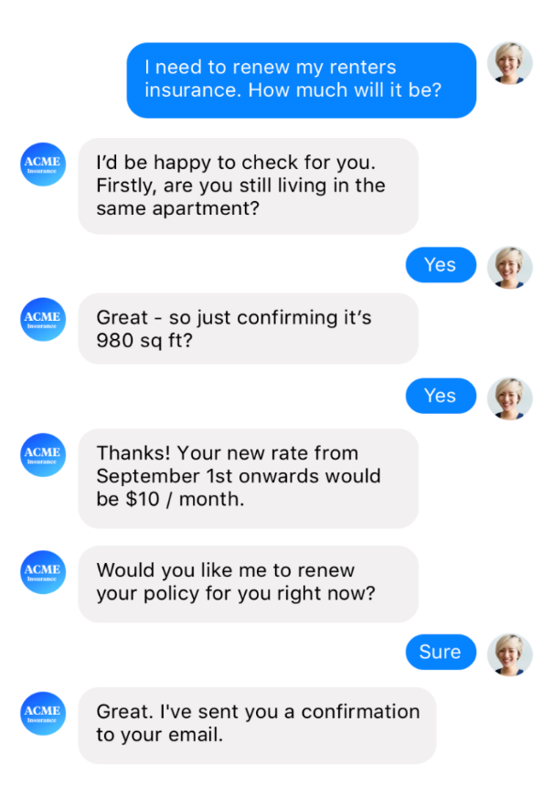
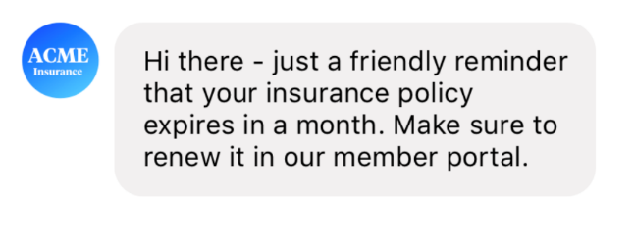
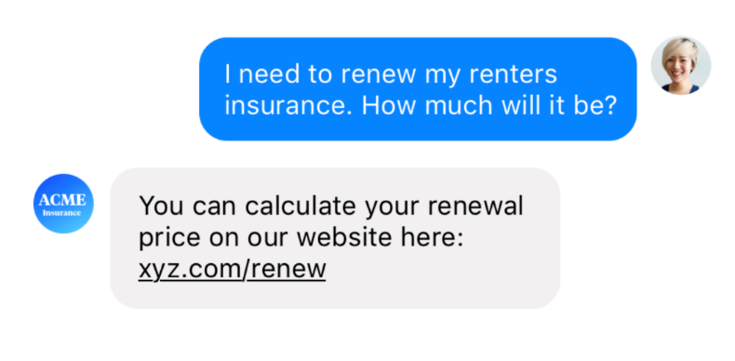


Notification Assistant
Generative AI- AI Assistants
Contextual Assistant
FAQ Assistant

Slide 24
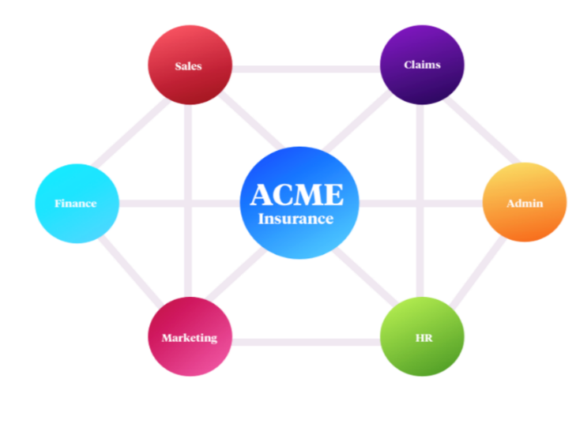
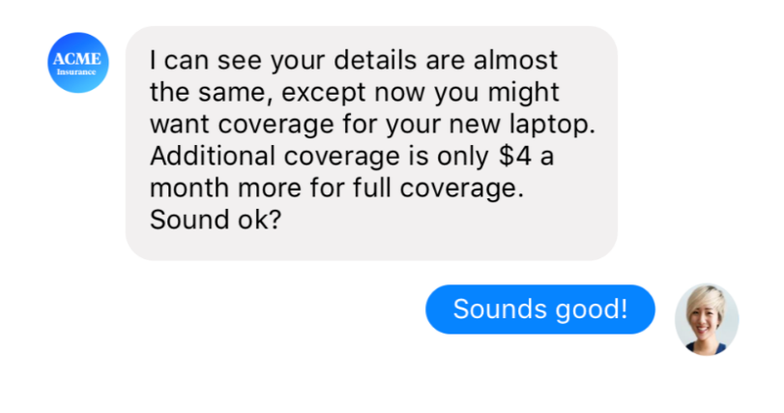

Personalized Assistant
Generative AI- AI Assistants
Autonomous Organization of Assistants
Assistant knows you much more in detail
Quickly checks a few final things before giving you a quote tailored to your actual situation.
Group of AI assistants that know every customer personally
Eventually run large parts of company operations—from lead generation over marketing, sales, HR, or finance

Slide 25
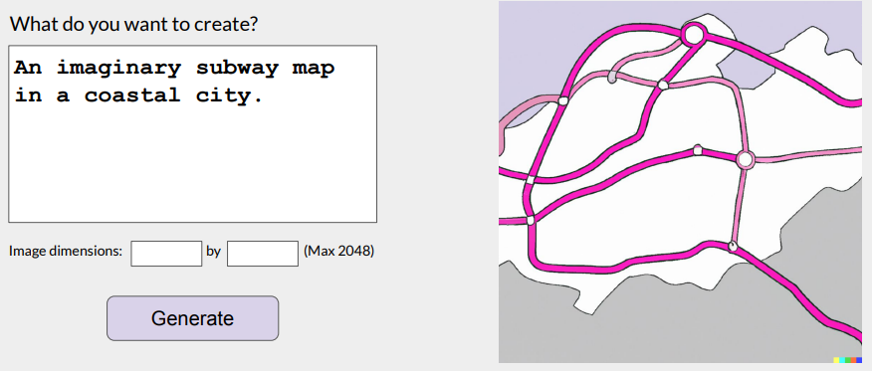
Generative AI- PaintBox

Slide 26
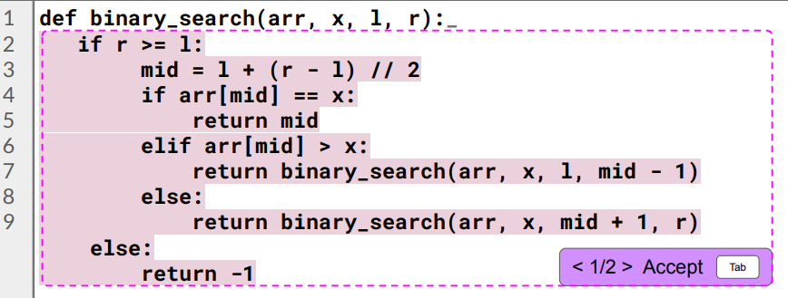
Generative AI- CodeAid

Slide 27
Real-life challenges in NLP tasks
Deep learning methods are data-hungry
>50K data items needed for training
The distributions of the source and target data must be the same
Labeled data in the target domain may be limited
This problem is typically addressed with transfer learning

Slide 28
Transfer Learning
Using a pre-trained model as a starting point for a new task or domain.
Leverage the knowledge acquired by the pre-trained model on a large dataset and apply it to a related task with a smaller dataset.
We can benefit from the general features and patterns learned by the pre-trained model, saving time and computational resources.
Transfer learning involves freezing the pre-trained model’s weights and only training the new layers
Ex: image classification, knowledge gained while learning to recognize cars could be applied when trying to recognize trucks

Slide 29










Transductive vs Inductive Transfer Learning
Transductive transfer
No labeled target domain data available
Focus of most transfer research in NLP
E.g. Domain adaptation
Inductive transfer
Labeled target domain data available
Goal: improve performance on the target task by training on other task(s)
Jointly training on >1 task (multi-task learning)
Pre-training (e.g. word embeddings)

Slide 30
Applications of Transfer Learning
Image Classification
Names Entity Recognition
Sentiment Analysis
Cross Lingual Learning
Gaming
Image Recognition
Speech Recognition

Slide 31
Fine Tuning
Fine-tuning takes it a step further by allowing the pre-trained layers to be updated.
Beneficial when the new dataset is large enough and similar to the original dataset on which the pre-trained model was trained

Slide 32
References
CH-7 - Speech and Language Processing by Daniel Jurafsky

Slide 33
https://www.youtube.com/watch?v=BtmsIy0j_dY&t=5s

